Slide 1
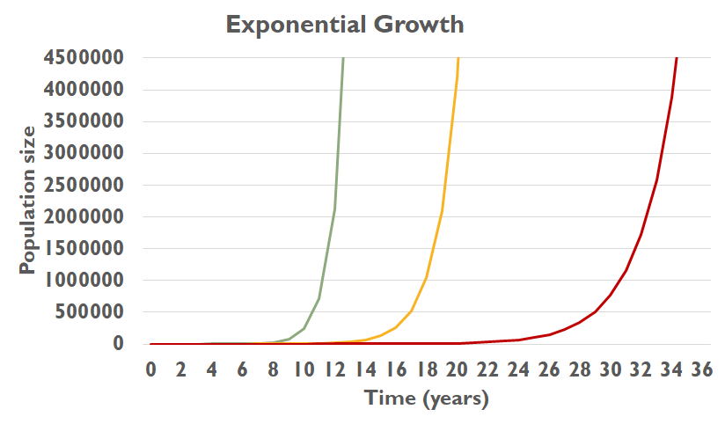
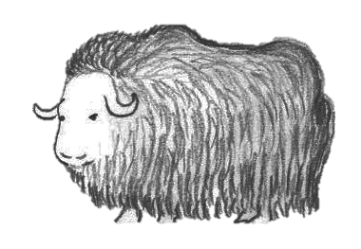
PLAY WITH 𝜆
𝜆 = 3
𝜆 = 2
𝜆 = 1.5
What would 𝜆 have to be to decrease the population?
Notes:
1.5 = Each musk ox has 1 offspring every other year

Slide 2
PLAY WITH 𝜆
Notes:
No offspring, population remains at 4

Slide 3
PLAY WITH 𝜆
Notes:
0 = population dies out! anything multiplied by 0 is 0!

Slide 4
PLAY WITH 𝜆
Notes:
Only 3 out of 4 muskoxen will survive from one year to the next which means we lose 25% of the population every year
This is an example of exponential decay

Slide 5
PLAY WITH 𝜆
Notes:
We lose 50% or half of the population every year

Slide 6
DECLINING POPULATION
What might cause muskox populations to decline?
Population Factors
Other Species
Environment
genetics, diseases, parasites, number of females, etc.
predators, competition from other herbivores, humans
habitat, food availability
Determinants of Population Health
Many factors determine the health of a population
Notes:
Discussion about the determinants of health

Slide 7
CARRYING CAPACITY
~ 85,000 muskoxen in Canada
Notes:
Dotted line = number of muskoxen currently in Canada
Solid line = exponential growth of muskoxen if lambda = 2
We would run out of resources if we had more muskoxen and the tundra would be completely bare so no other herbivores could live. Carrying capacity: the number of people, other living organisms, or crops that a region can support without environmental degradation on the tundra.

Slide 8
CARRYING CAPACITY
~ 85,000 muskox in Canada
Notes:
Therefore there is a carrying capacity, or the amount of animals that the environment can sustain. Instead of increasing forever in an exponential growth model, this model predicts that as the population reaches the carrying capacity, the growth rate will slow so the population doesn’t go over the carrying capacity. This model is called logistic growth.

Slide 9
SUMMARY
We can see how a population is doing by estimating what λ is
If λ is greater than 1: the population grows exponentially
If λ is equal to 1: the population doesn’t change
If λ is less than 1: the population decreases exponentially
In real life, population size is limited by carrying capacity.

Slide 10
RECAP
We can see how a population is doing by estimating what λ is
If λ is greater than 1: the population grows exponentially
If λ is equal to 1: the population doesn’t change
If λ is less than 1: the population decreases exponentially
In real life, population size is limited by carrying capacity.

Slide 11
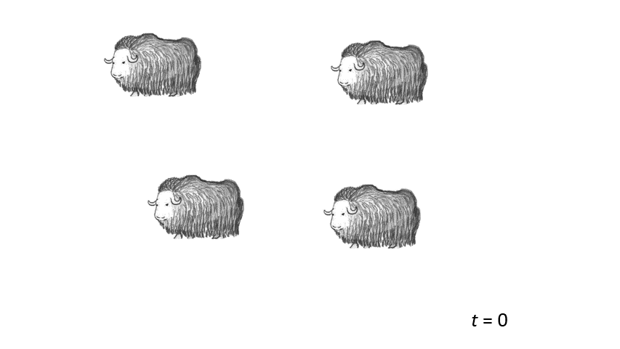
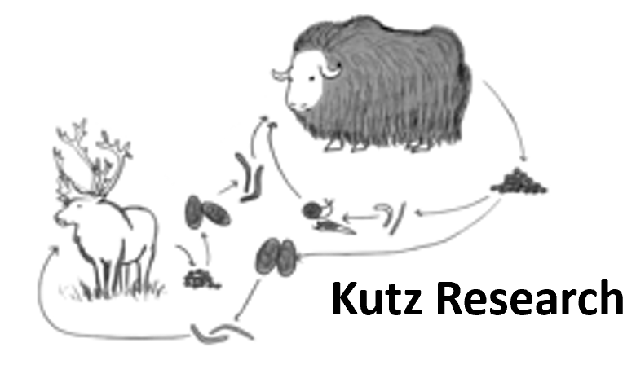
POPULATION CYCLING
Notes:
But sometimes the population can go in cycles, increasing and decreasing based on many different factors interacting.

Slide 12
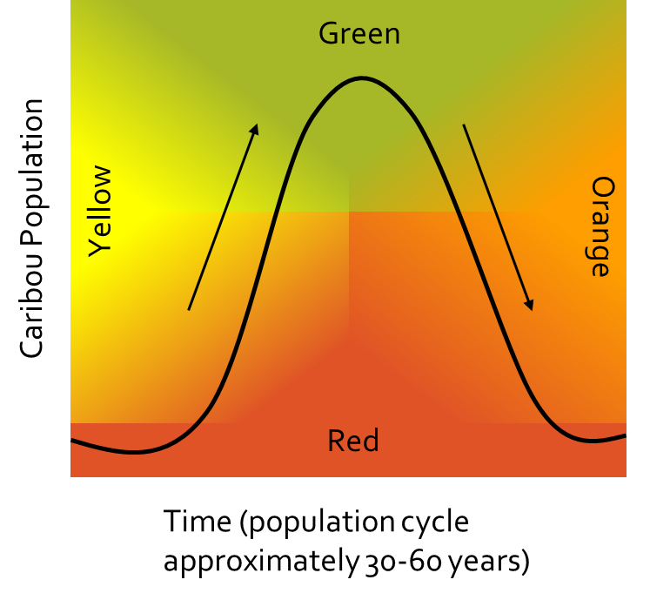
LET’S PLAY: POPULATION CYCLES
Yellow: Population level is intermediate and increasing
Green: Population level is high
Orange: Population level is intermediate and declining
Red: Population level is low
What do you think the animals will look like in each stage?
Notes:
What do you think the animals will look like in each stage? How much fat will they have? Why?
yellow = lots of resources still, well conditioned animals, not too fat or too skinny
green = running out of resources, too many animals, animals getting skinny
Orange = population decreasing, but resources may not have recovered yet, so may still have skinny animals
red = resources start to grow again so animals are getting fatter
Advisory Committee for Cooperation on Wildlife Management. 2014. Taking Care of Caribou: the Cape Bathurst, Bluenose-West, and Bluenose-East barren-ground caribou herds management plan. Yellowknife, NT.

Slide 13
Notes:
Select 3 student volunteers. Each student will be a caribou. Start the game with 10 “plants” (some form of candy). Each of the 3 students gets 2 “plants” to eat. They may eat if they wish. Explain that the caribou have a lot of food, more than they can eat and get fat and reproduce. 1 caribou dies from disease or predation by wolves (Ask 1 student to sit down).

Slide 14
Notes:
Because we had such a good year the first year, we now have more caribou. Recruit 4 more students from the class to become caribou (2 standing students can each pick 2 more students). The plants grew well too, so we have 12 plants. Each student gets 2 “plants” (candy) to eat. 2 caribou die from disease or predation by wolves (Ask 2 students to sit down).

Slide 15
Notes:
However, we still had a good year with enough plants to go around. All the students are caribou now (even the 3 that were predated can come back as new caribou). We have 12 plants. Give every student only 1 candy, starting with the new caribou. If there is not enough candy to go around (12 max), the caribou who did not get plants will starve. Ask these students to sit down (try to pick students who were standing the longest to sit). Since caribou only got half of what they usually get to eat, they are becoming skinny. With greater density of caribou, more caribou may die from disease and predation. Ask 3 students to sit down due to disease or predation.

Slide 16
Notes:
The next year, we still have a lot of caribou, but our plant population hasn’t recovered and we only have 6 plants. Give every student 1 candy. If there is not enough candy to go around (6 max), the caribou who did not get plants will starve, ask them to sit down. Our caribou population is decreasing, but there are still predators and disease. Ask 3 students to sit down from predation and disease.

Slide 17
Notes:
The next year, we a small population of caribou and our plant population has started to recover. Give every student 2 candies. There is still disease and predation. Ask 1 student to sit down from predation or disease.
However, there are not enough caribou to support the wolf population anymore so some of the wolves die.

Slide 18
Notes:
The next year, our caribou population is still small, but growing and the plants have recovered. We are back to the beginning of the cycle!

Slide 19
What did you notice about the rise and fall of the caribou population?
What drove the population to increase and decrease?
What about the wolves?

Slide 20
POPULATION CYCLING
Density-Dependent limiting factors: as population size increases and density increases, the growth rate decreases
For example:
Density-Independent limiting factors: factors that affect growth rate independent of population density
For example:
Limiting factors can interact in complex ways to produce patterns of population growth
Notes:
Resource (food): storms can decrease resources
Predators (wolves, hunters)
Disease, pathogens, Adverse weather
What if we looked at competitors for resources, like the hare population takes off so wolves hunt them instead and the wolf population increases? The hares are also eating similar foods as the caribou so there are less resources.
In nature, population size and growth are limited by many factors. Some are density-dependent, while others are density-independent.
Density-dependent limiting factors cause a population's per capita growth rate to change—typically, to drop—with increasing population density. One example is competition for limited food among members of a population.
Density-independent factors affect per capita growth rate independent of population density. Examples include natural disasters like forest fires.
Limiting factors of different kinds can interact in complex ways to produce various patterns of population growth. Some populations show cyclical oscillations, in which population size changes predictably in a cycle.
all the factors that influence health (food availability, number of caribou, predators, hunters, other factors such as pathogens/disease and weather).

Slide 21
PREDATOR-PREY MODEL
What did you notice?
Time (years) | Wolf Population | Caribou Population
0 | 3 | 10
5 | 4 | 16
10 | 5 | 20
15 | 7 | 14
20 | 8 | 4
25 | 4 | 6
30 | 3 | 12
35 | 5 | 15
40 | 6 | 21
45 | 9 | 18
50 | 11 | 13
55 | 10 | 5
60 | 8 | 3
65 | 4 | 9
Population
Time (years)
Notes:
What did you notice? The wolf population rises after the caribou population rises. Then the wolf population falls after the caribou population falls. Without predation by wolves, the caribou population can rise again. And then with more food available, the wolf population can rise again. But too much predation makes the caribou population fall. !nd so on!
In nature, population size and growth are limited by many factors. Some are density-dependent, while others are density-independent.
Density-dependent limiting factors cause a population's per capita growth rate to change—typically, to drop—with increasing population density. One example is competition for limited food among members of a population.
Density-independent factors affect per capita growth rate independent of population density. Examples include natural disasters like forest fires.
Limiting factors of different kinds can interact in complex ways to produce various patterns of population growth. Some populations show cyclical oscillations, in which population size changes predictably in a cycle.

Slide 22
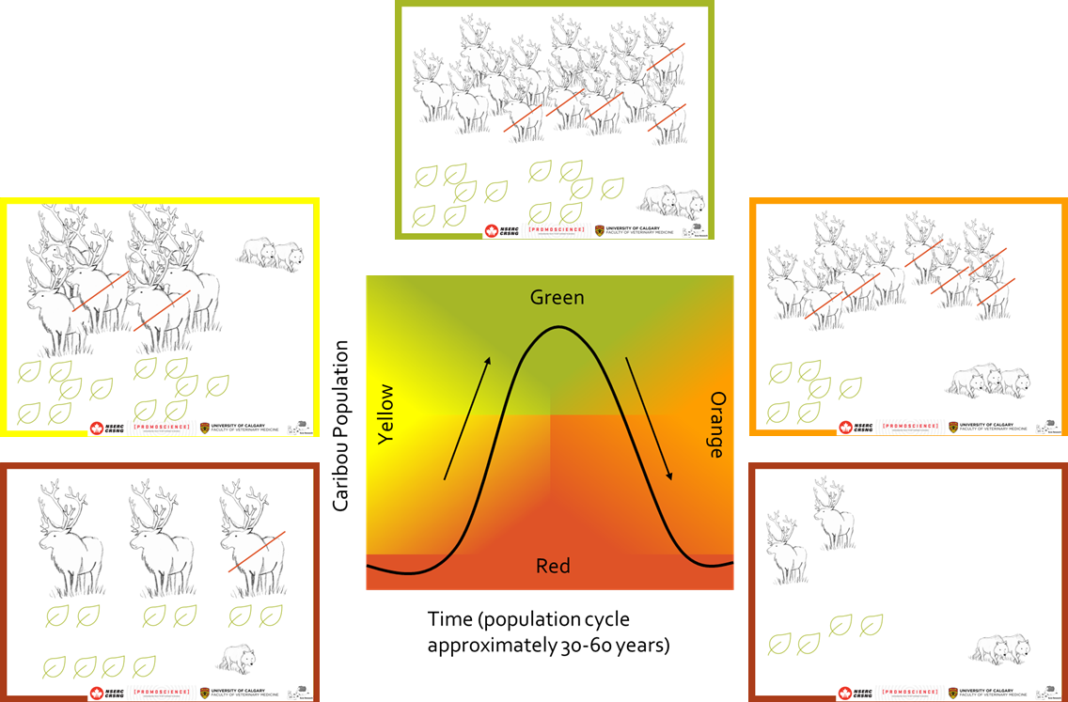
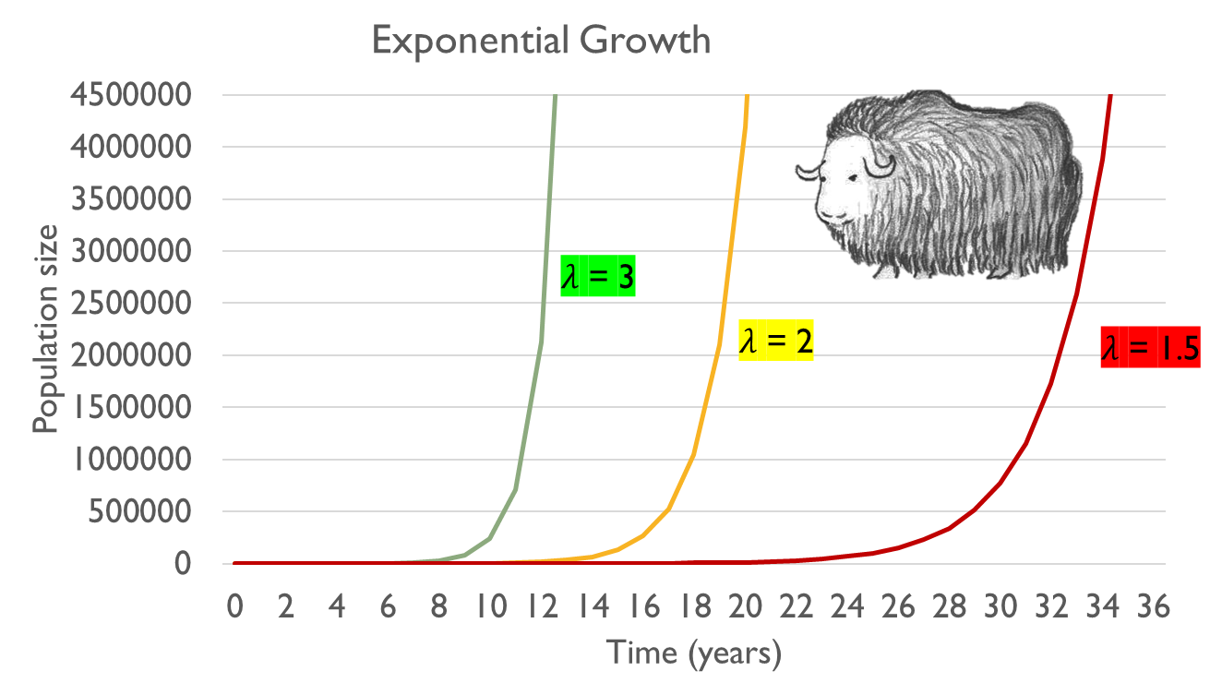
SUMMARY
POPULATION SIZE IS AN INDICATOR OF HEALTH AND CAN BE INFLUENCED BY MANY FACTORS

